Slide 1
Lecture 16:
Diastereomers
Enantiomers
How to identify them?

Slide 2
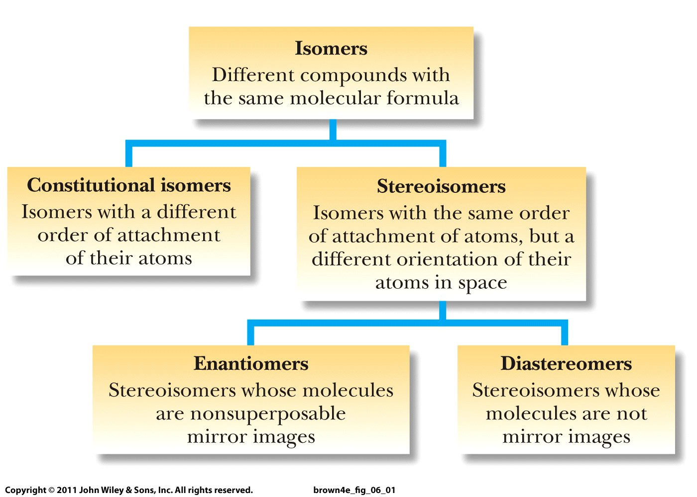

Slide 3
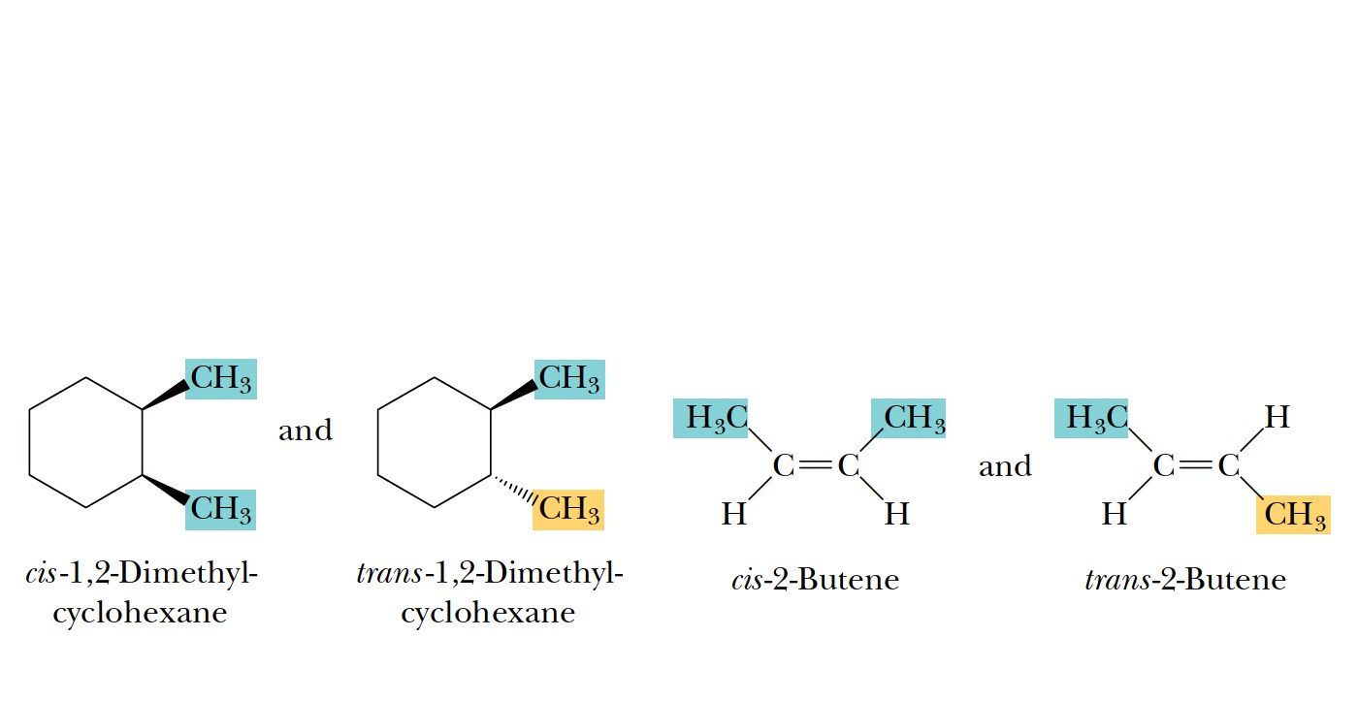
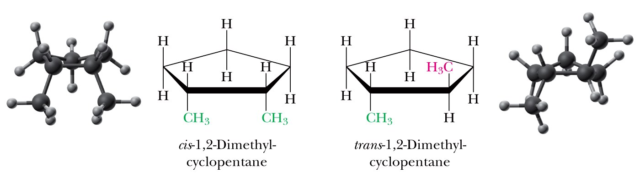
Diastereomers (already discussed):

Slide 4
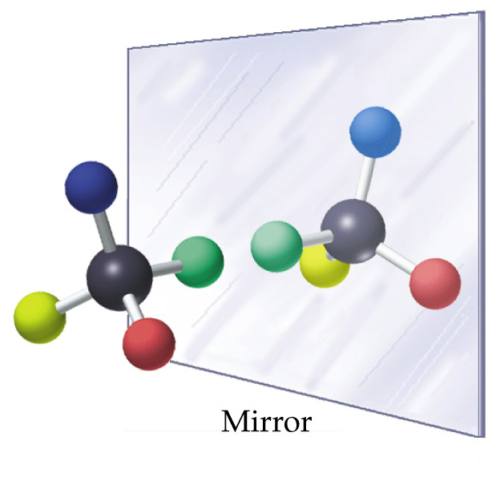
Enantiomers usually have at least one carbon
with four different groups bound to it
= chiral center
= stereocenter

Slide 5
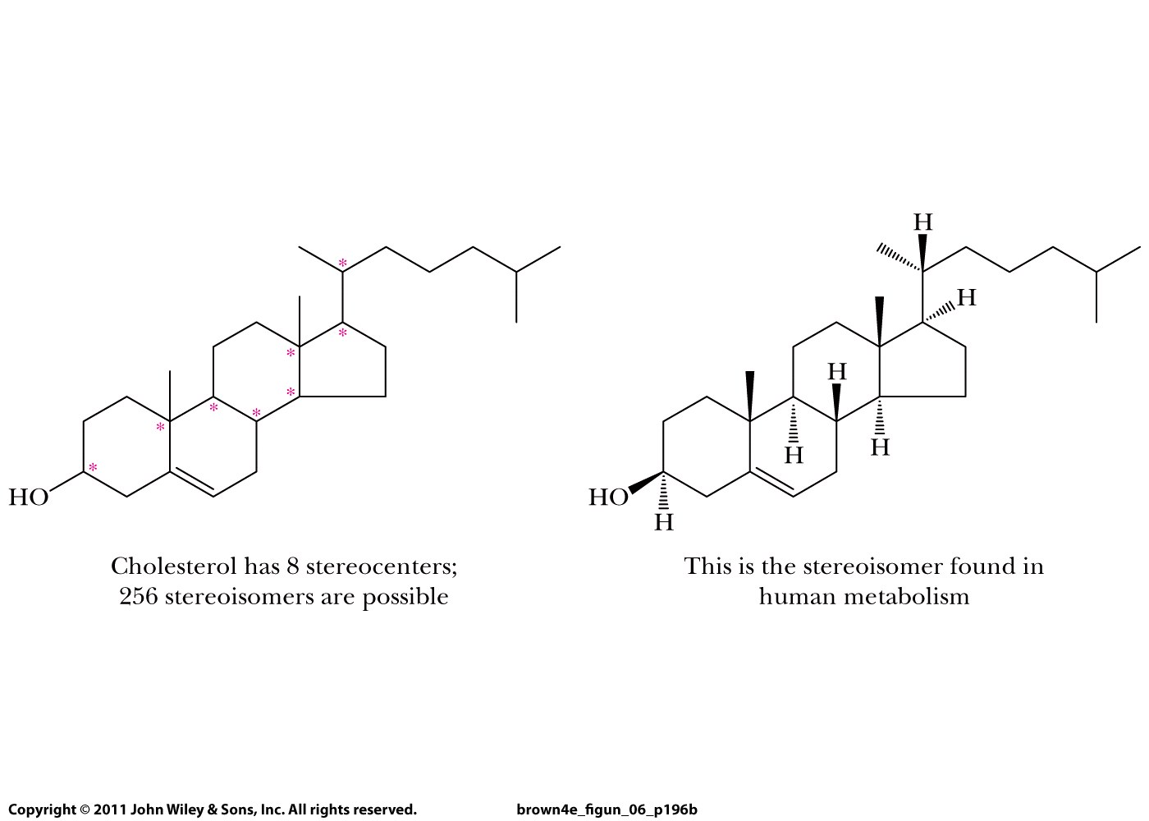

Slide 6
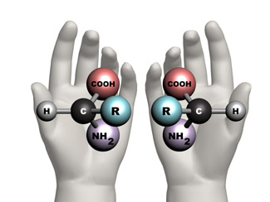
Enantiomers or mirror image isomers (new):

Slide 7
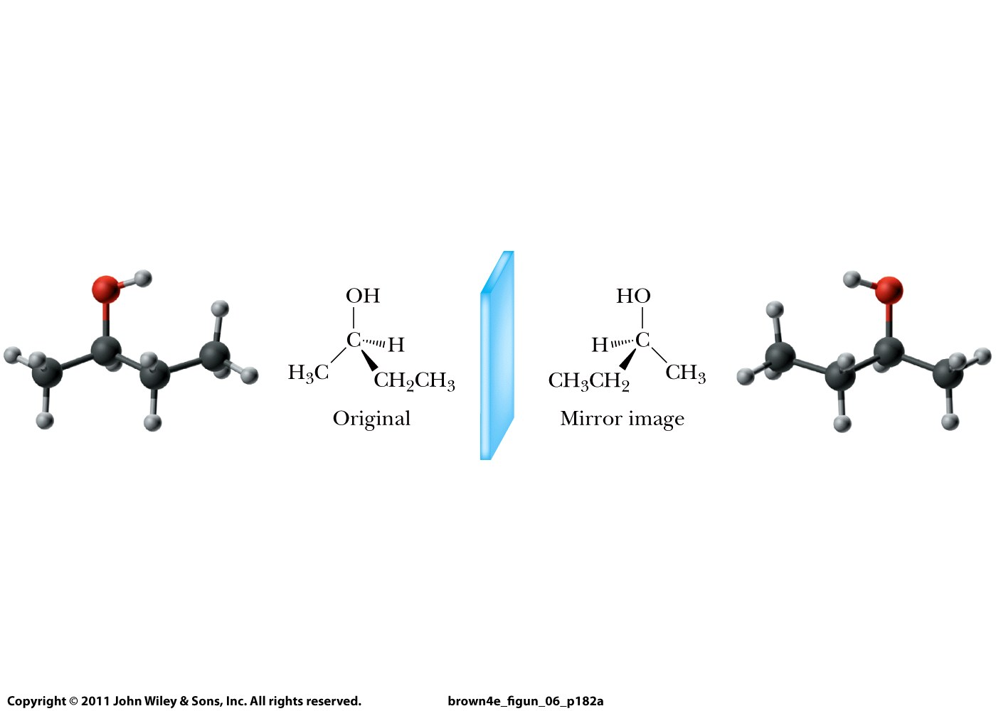

Slide 8
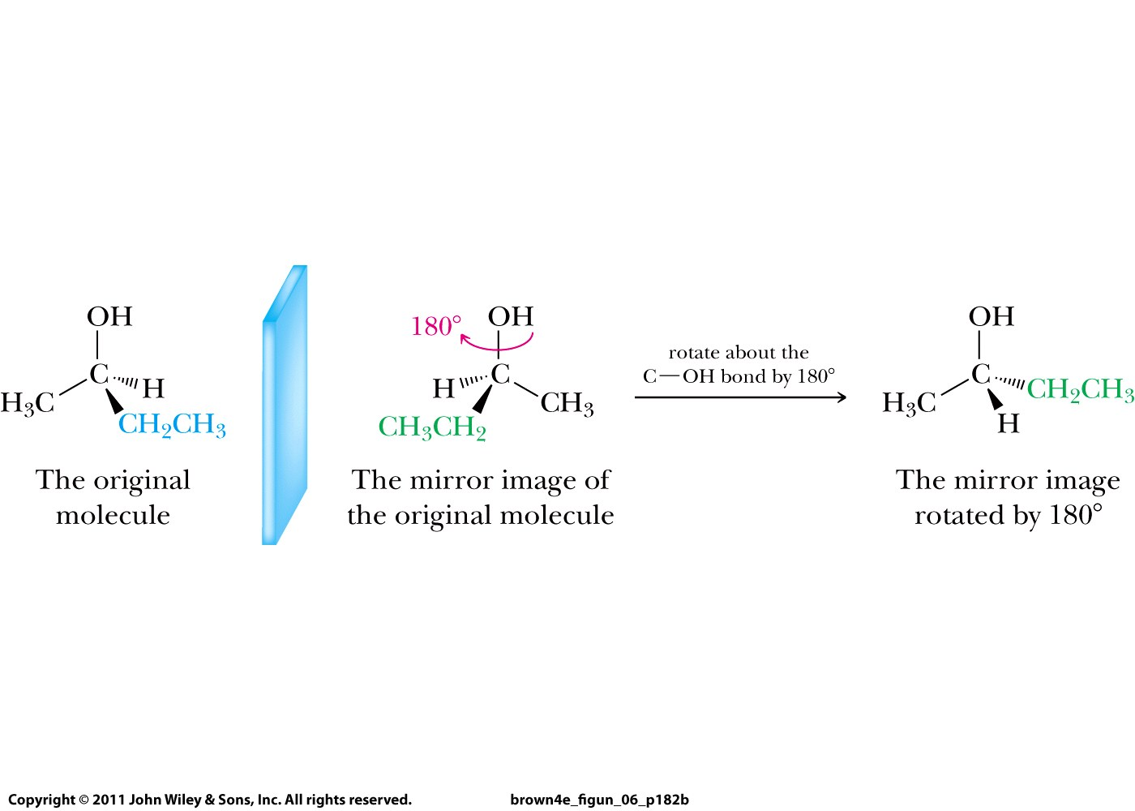

Slide 9
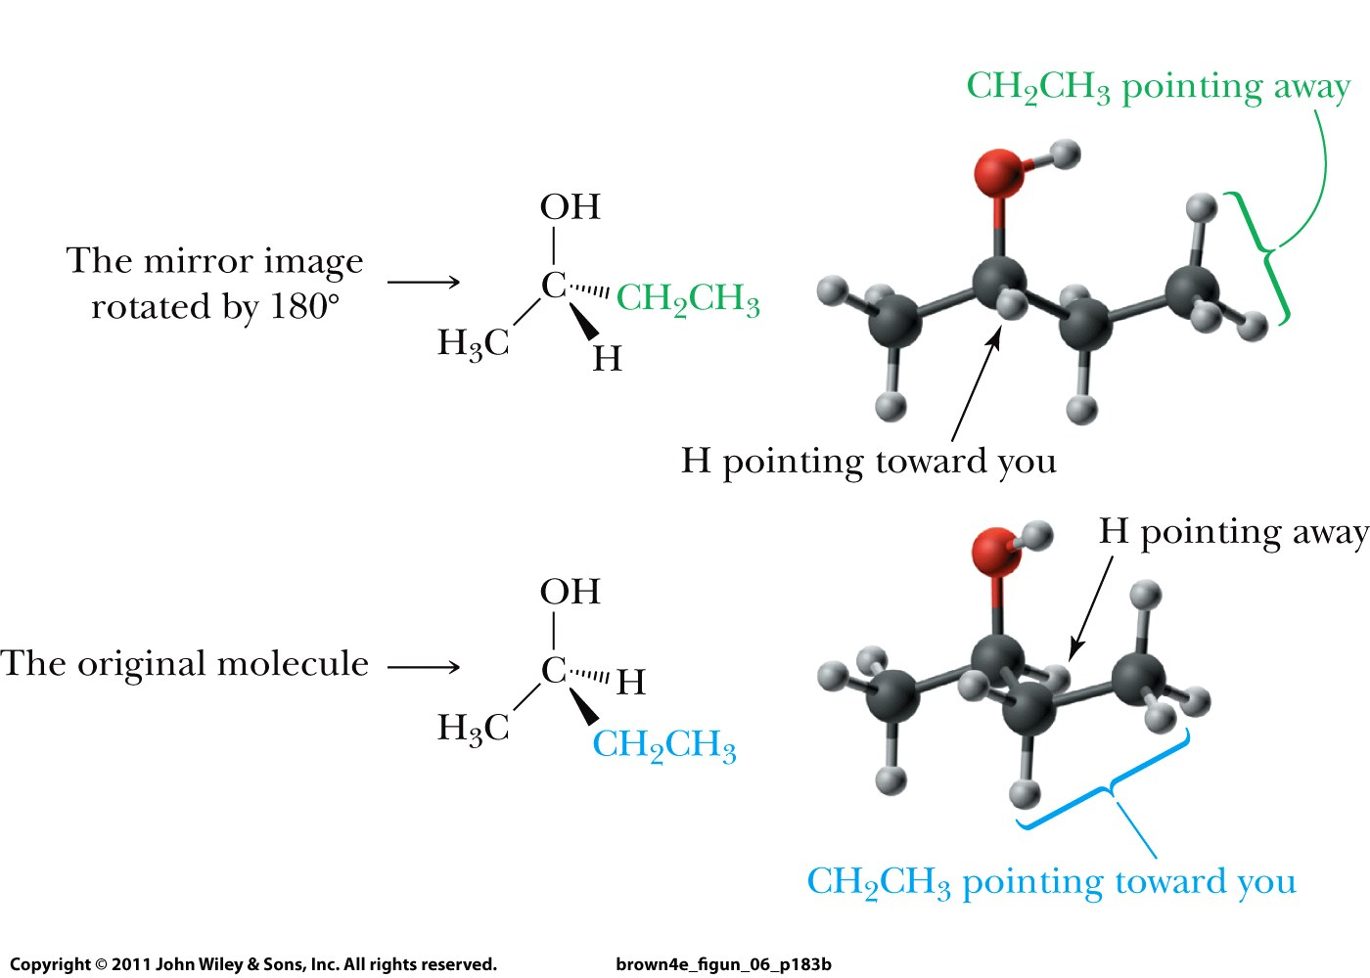

Slide 10
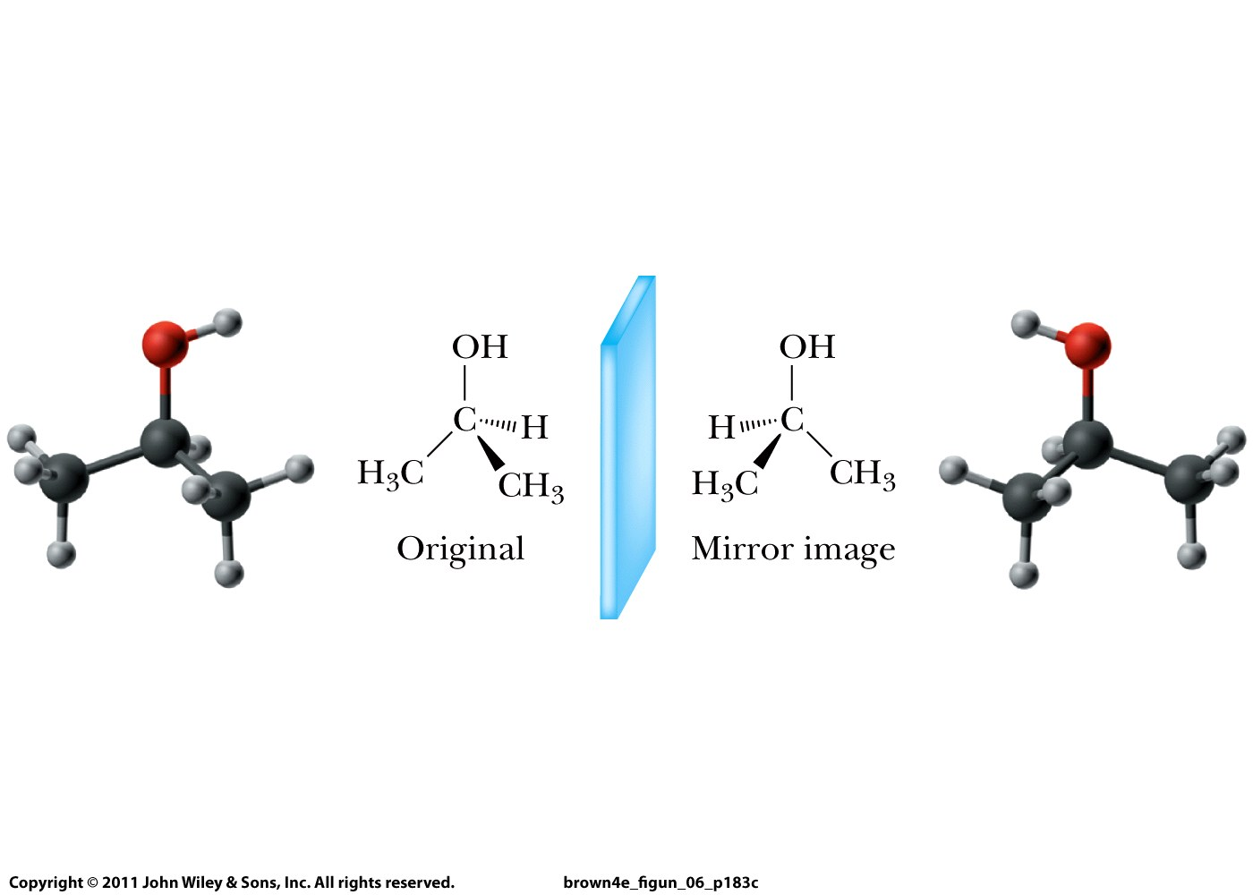
No enantiomers when two substitutents are identical =
Achiral molecule

Slide 11
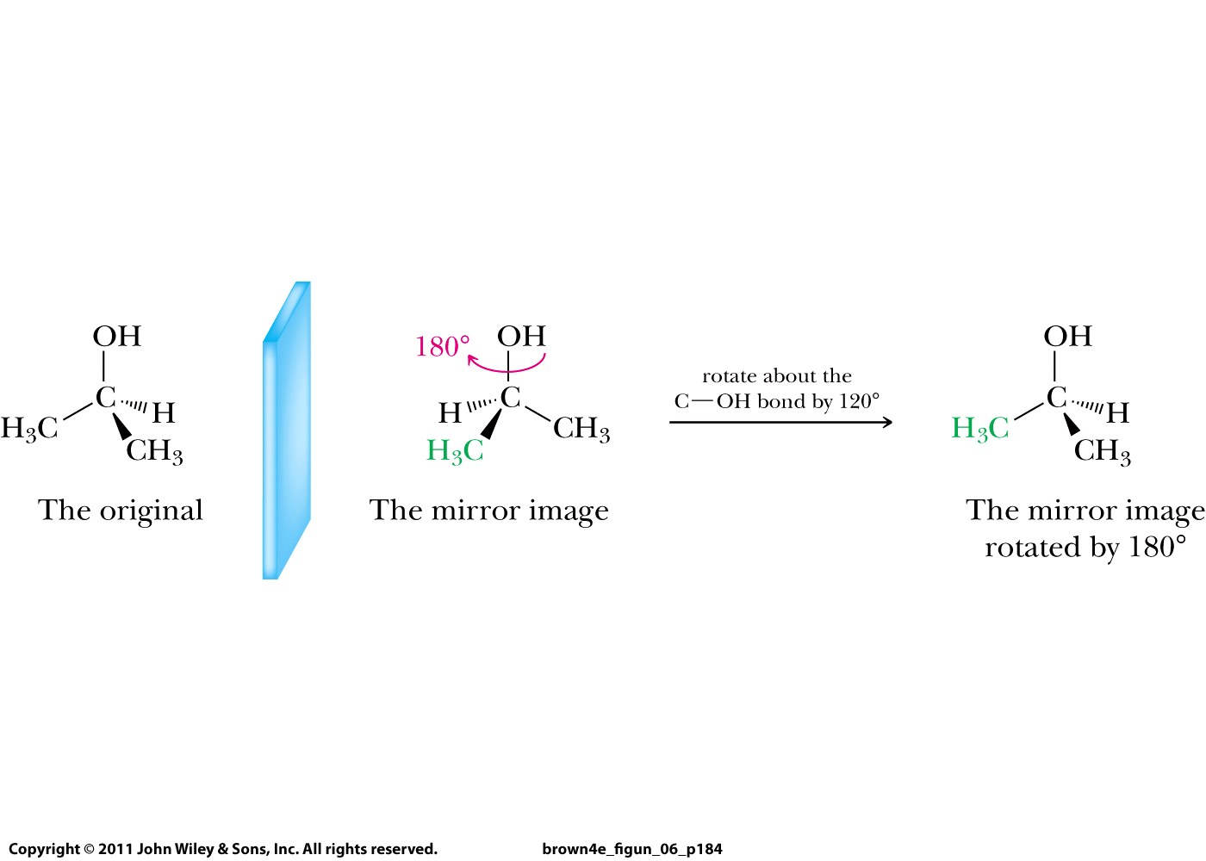
No enantiomers when two substitutents are identical =
Achiral molecule

